Slide 2
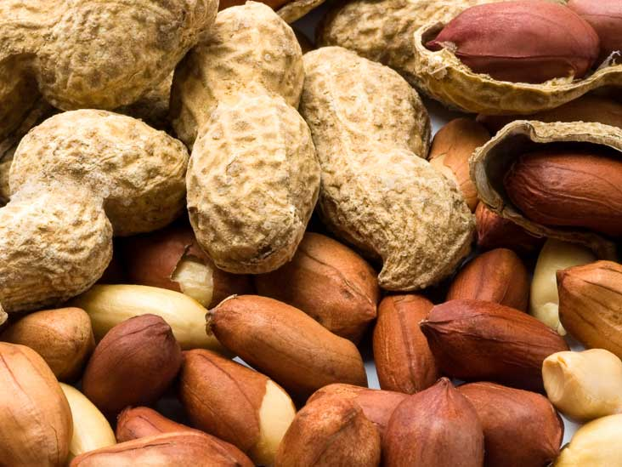
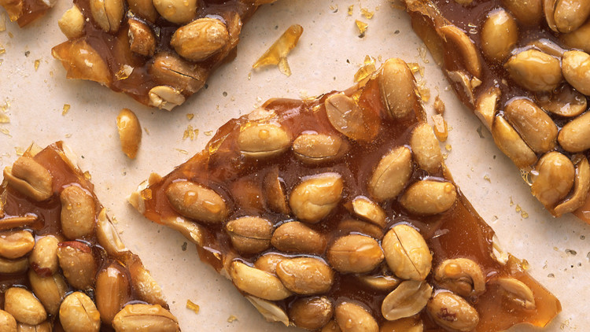
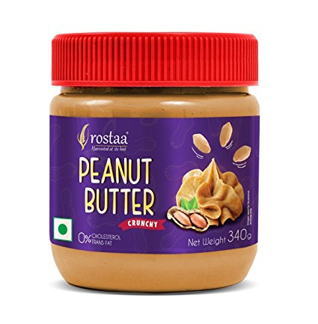
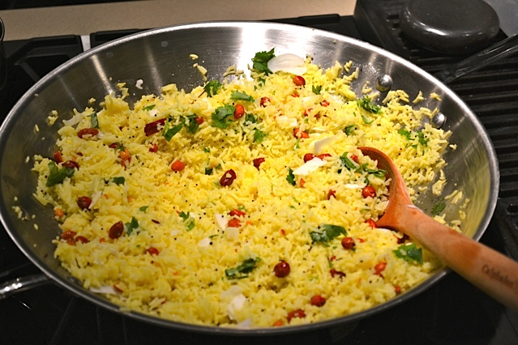
Peanuts(mungfali)jagoo

Slide 3
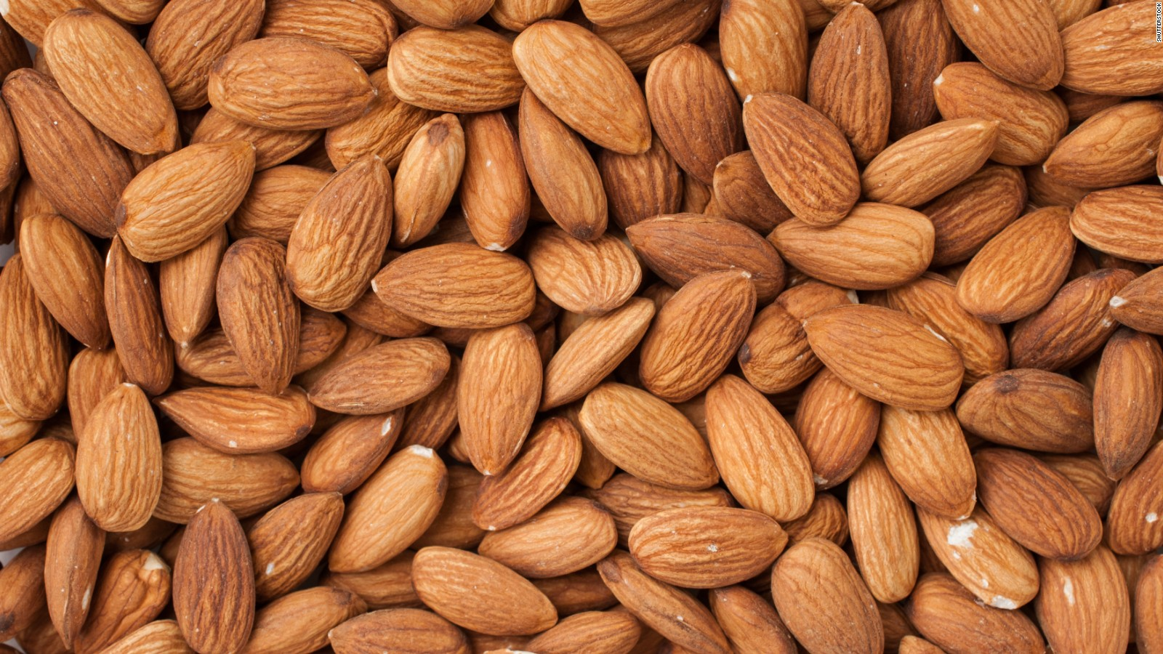
Almonds(badam)

Slide 4
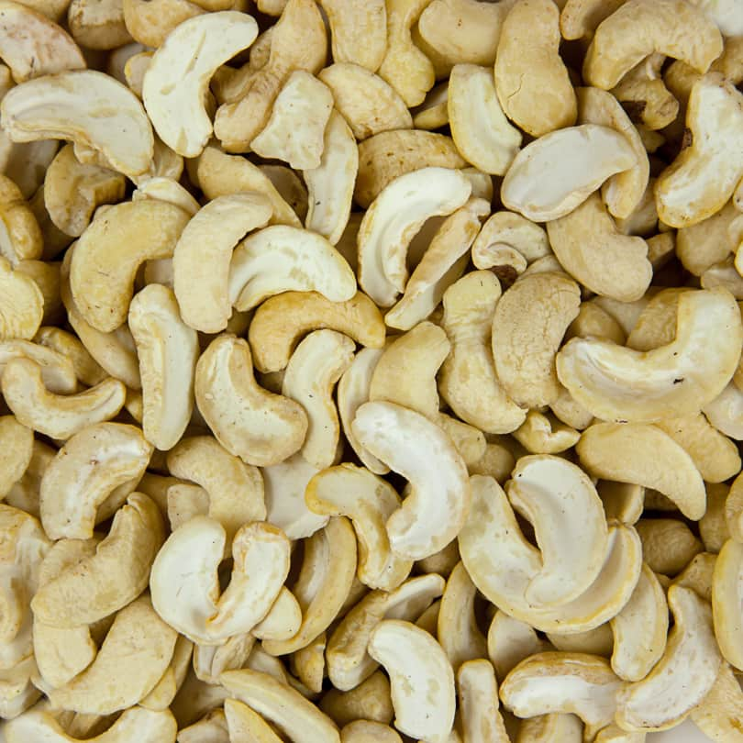
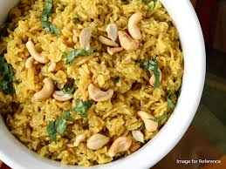
Cashew nuts(kajoo)

Slide 5
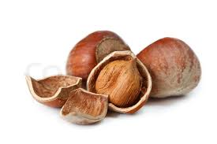
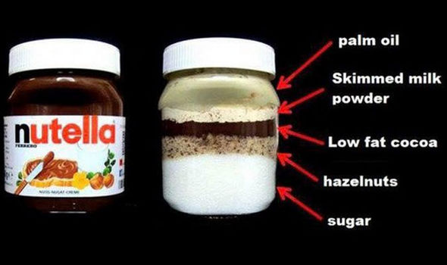
Hazelnut

Slide 6
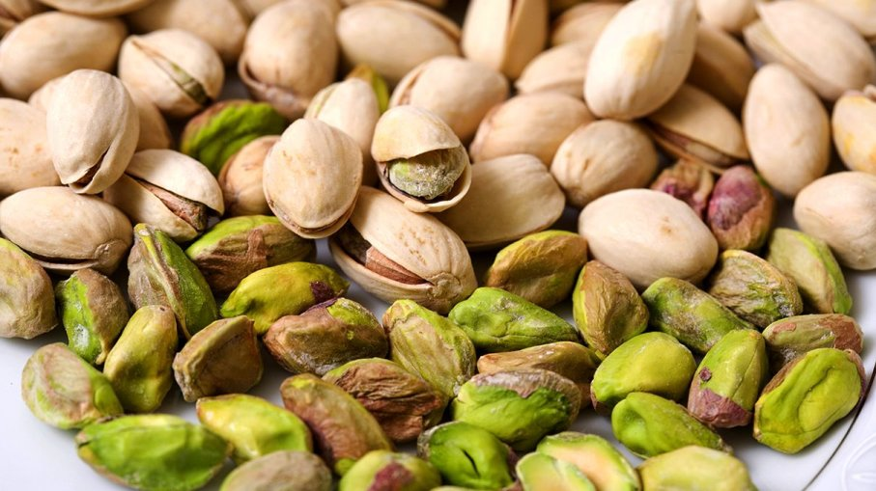
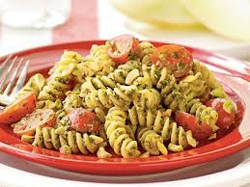
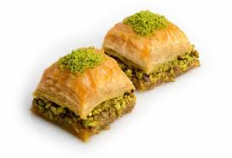
Pistachio(pista)

Slide 7
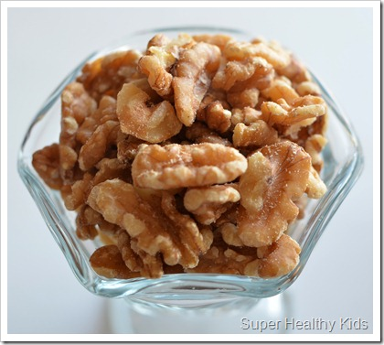
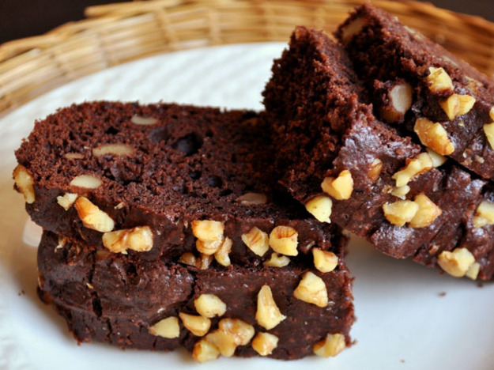
Walnuts(akhrot)

Slide 8
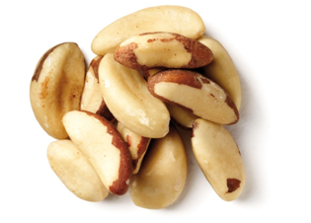
Brazil nut(brajhila badama)

Slide 9
Nuts in oil

Slide 10
Peanuts
PEANUTS
Arachis hypogaea | Groundnuts
Beer nuts | Goober nut/pea
Cacahuete | Mandelonas
Chinese nuts | Monkey nuts
Earthnuts

Slide 11
Tree Nuts
TREE NUTS
Almond | Macadamia
Brazil | Pecan
Cashew | Pistachio
Hazelnut | Walnut

Slide 12
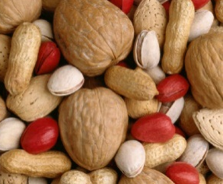
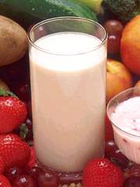
Food Allergy Vs. Food Intolerance
Food allergy is a potentially serious immune response to eating certain foods.
Food Intolerance is an adverse reaction to food that does not involve the immune system and is not life-threatening.
Symptoms of food intolerance
Might include abdominal cramps, bloating and diarrhea
Notes:
There has been an increase in food intolerance. People often confuse food intolerance with food allergies.
Common symptoms of food intolerance are gastric discomfort and diarrhea. Eliminating the food will eliminate the symptoms.
The example of lactose intolerance is presented here.
Other common food intolerances that you might hear about are: Gluten or Monosodium Glutamate (MSG).

Slide 13
One or more symptoms:
Can occur within minutes up to hours
Can be mild to life-threatening
SYMPTOMS
Trouble swallowing
Shortness of breath
Repetitive coughing
Voice change
Swelling
Hives
Eczema
Itchy red rash
Nausea & vomiting
Diarrhea
Abdominal cramping
Drop in blood pressure
Loss of consciousness
Notes:
The Food Allergy and Anaphylaxis Network, FAAN, reports in their “Frequently Asked Questions” section that one or more food allergic symptoms can occur within minutes up to hours after eating the food and the symptoms can be mild to life-threatening.
Not everyone is aware of the symptoms of food allergic reactions and a delay in responding to the symptoms can be life threatening. Education and training is encouraged to increase the awareness of food allergy with all members of the school community.
According to an article in the Journal of Pediatrics by Dr. Scott H. Sicherer (Sish- err – err) in 2001, foods used in class projects or celebrations are the primary cause of allergic reactions in school: 79% of reactions occurred in classroom and 12% of the reactions occurred in the lunchroom.

